Slide 1
Machine Learning 4/5
2015.12.31(목)
박지현

Slide 2
Unsupervised Learning
Clustering
Dimensionality Reduction
Motivation
Principal Component Analysis (PCA)
Applying PCA
Anomaly Detection
Density Estimation
Building an Anomaly Detection System
Multivariate Gaussian Distribution

Slide 3
Unsupervised Learning
Clustering
Dimensionality Reduction
Motivation
Principal Component Analysis (PCA)
Applying PCA
Anomaly Detection
Density Estimation
Building an Anomaly Detection System
Multivariate Gaussian Distribution

Slide 4
Unsupervised Learning
상세 내용
Unsupervised learning
Talk about clustering
Learning from unlabeled data
Unsupervised learning
Useful to contras with supervised learning
Compare and contrast
Supervised learning
Given a set of labels, fit a hypothesis to it
Unsupervised learning
Try and determining structure in the data
Clustering algorithm groups data together based on data features
What is clustering good for
Market segmentation - group customers into different market segments
Social network analysis - Facebook "smart lists”
Organizing computer clusters and data centers for network layout and location
Astronomical data analysis - Understanding galaxy formation

Slide 5
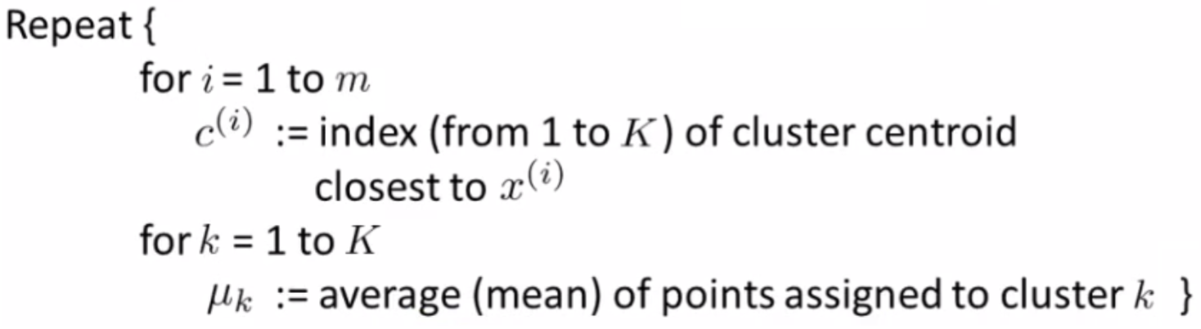
Unsupervised Learning
상세 내용
K-means algorithm
Want an algorithm to automatically group the data into coherent clusters
K-means is by far the most widely used clustering algorithm

Slide 6
Unsupervised Learning
상세 내용
Step 1: Randomly allocate two points as the cluster centroids
Have as many cluster centroids as clusters you want to do (K cluster centroids, in fact)
In our example we just have two clusters
Step 2: Cluster assignment step
Go through each example and depending on if it's closer to the red or blue centroid assign each point to one of the two clusters
To demonstrate this, we've gone through the data and "colour" each point red or blue
Step 3: Move centroid step
Take each centroid and move to the average of the correspondingly assigned data-points

Slide 7
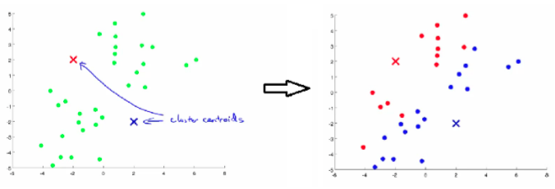
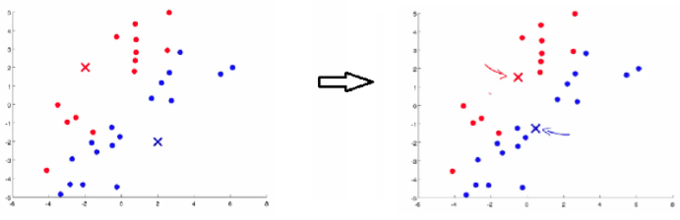
Unsupervised Learning
상세 내용

Slide 8
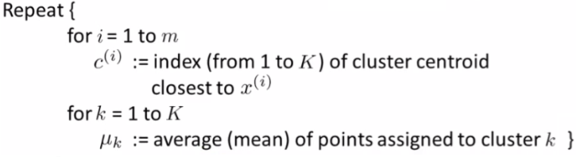
Unsupervised Learning
상세 내용
Input:
K (number of clusters in the data)
Training set {x1, x2, x3 ..., xn)
Algorithm:
Randomly initialize K cluster centroids as {μ1, μ2, μ3 ... μK}
Loop 1
This inner loop repeatedly sets the c(i) variable to be the index of the closes variable of cluster centroid closes to xi
i.e. take i th example, measure squared distance to each cluster centroid, assign c(i) to the cluster closest
Loop 2
Loops over each centroid calculate the average mean based on all the points associated with each centroid from c(i)

Slide 9
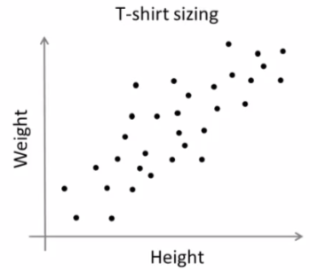
Unsupervised Learning
상세 내용
K-means for non-separated clusters
So far looking at K-means where we have well defined clusters But often K-means is applied to datasets where there are not well defined clusters
e.g. T-shirt sizing

Slide 10
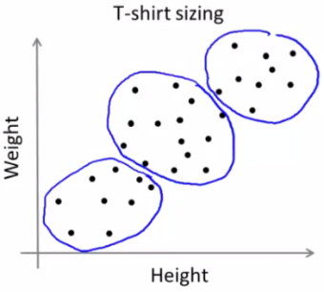
Unsupervised Learning
상세 내용
So creates three clusters, even though they aren't really there
Look at first population of people
Try and design a small T-shirt which fits the 1st population
And so on for the other two This is an example of market segmentation
Build products which suit the needs of your subpopulations

Slide 11
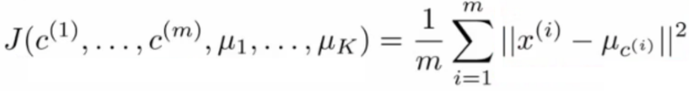
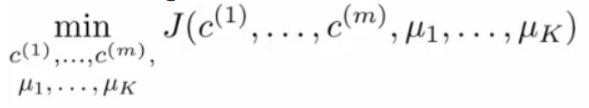
Unsupervised Learning
상세 내용
K means optimization objective
Supervised learning algorithms have an optimization objective (cost function)
K-means does too
K-means has an optimization objective like the supervised learning functions we've seen
Why is this good?
Knowing this is useful because it helps for debugging
Helps find better clusters
Using this notation we can write the optimization objective;

Slide 12
Unsupervised Learning
상세 내용
K means optimization objective
If we consider the k-means algorithm
The cluster assigned step is minimizing J(...) with respect to c1, c2 ... ci
i.e. find the centroid closest to each example
Doesn't change the centroids themselves
The move centroid step
We can show this step is choosing the values of μ which minimizes J(...) with respect to μ

Slide 13
Unsupervised Learning
상세 내용
Random initialization
How we initialize K-means
And how avoid local optimum
Consider clustering algorithm
Never spoke about how we initialize the centroids
A few ways - one method is most recommended
Have number of centroids set to less than number of examples (K < m, if K > m we have a problem)
Randomly pick K training examples
Set μ1 up to μK to these example's values
K means can converge to different solutions depending on the initialization setup
Risk of local optimum

Slide 14
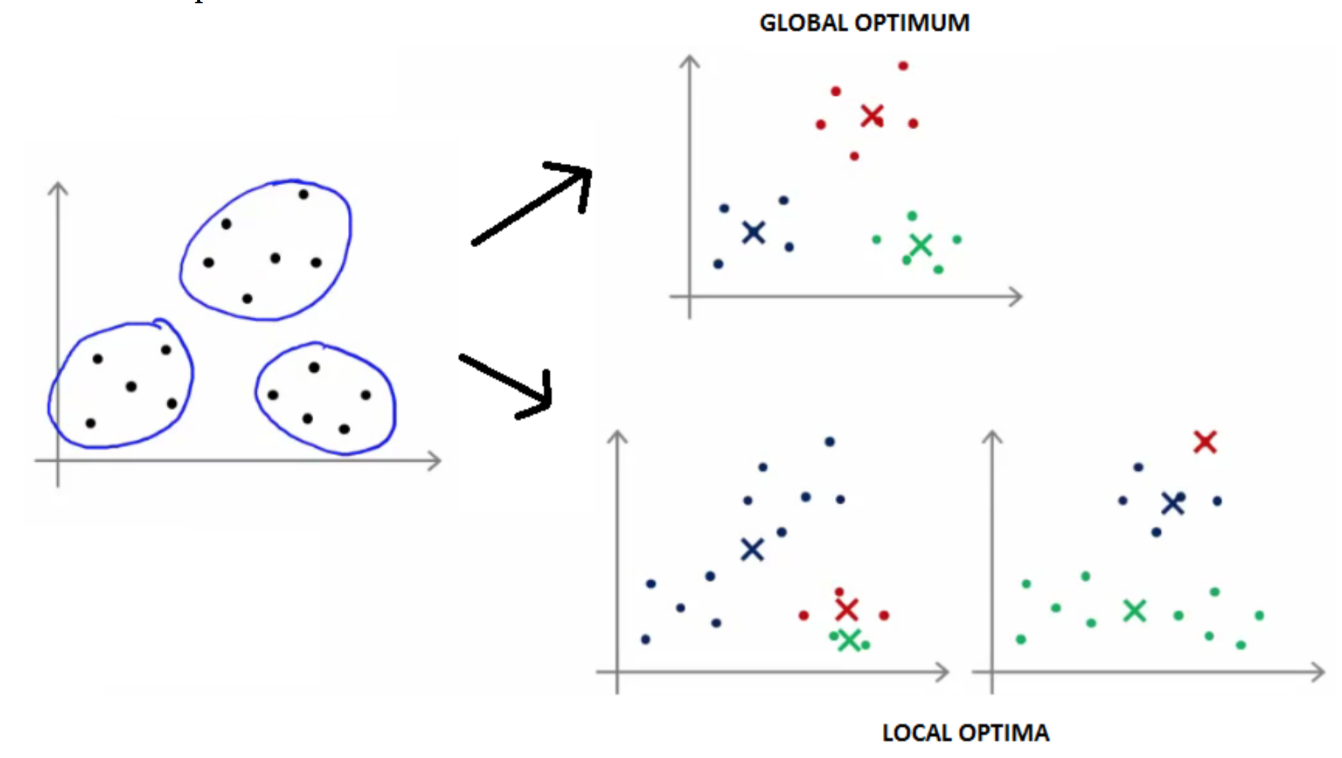
Unsupervised Learning
상세 내용
Random initialization
If this is a concern
We can do multiple random initializations
See if we get the same result - many same results are likely to indicate a global optimum

Slide 15
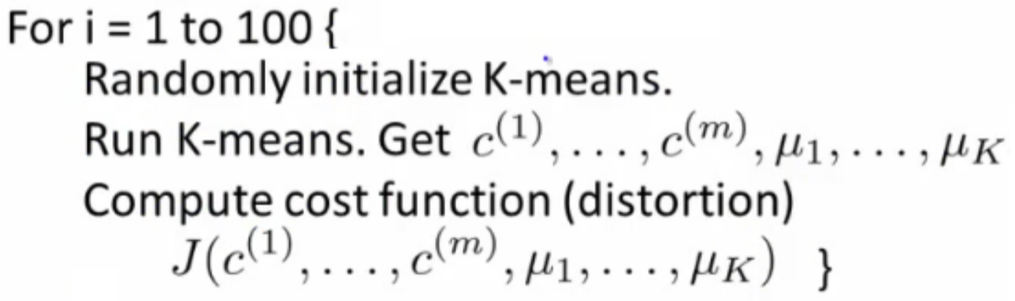
Unsupervised Learning
상세 내용
Random initialization
Algorithmically we can do this as follows;
A typical number of times to initialize K-means is 50-1000
Randomly initialize K-means
For each 100 random initialization run K-means
Then compute the distortion on the set of cluster assignments and centroids at convergent
End with 100 ways of cluster the data
Pick the clustering which gave the lowest distortion

Slide 16
Unsupervised Learning
상세 내용
How do we choose the number of clusters?
Choosing K?
Not a great way to do this automatically
Normally use visualizations to do it manually
Why is this hard
Sometimes very ambiguous
e.g. two clusters or four clusters
Not necessarily a correct answer
This is why doing it automatic this is hard
Elbow method
Vary K and compute cost function at a range of K values
As K increases J(...) minimum value should decrease (i.e. you decrease the granularity so centroids can better optimize)

Slide 17
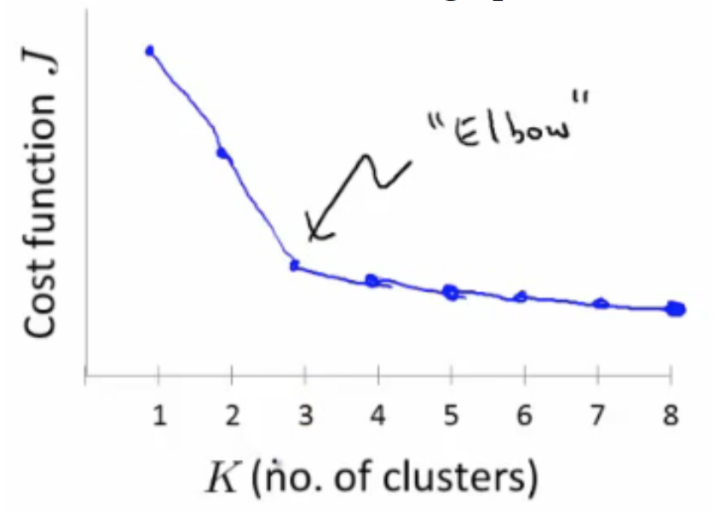
Unsupervised Learning
상세 내용
Elbow method
Chose the "elbow" number of clusters
If you get a nice plot this is a reasonable way of choosing K
Risks
Normally you don't get a a nice line -> no clear elbow on curve
Not really that helpful

Slide 18
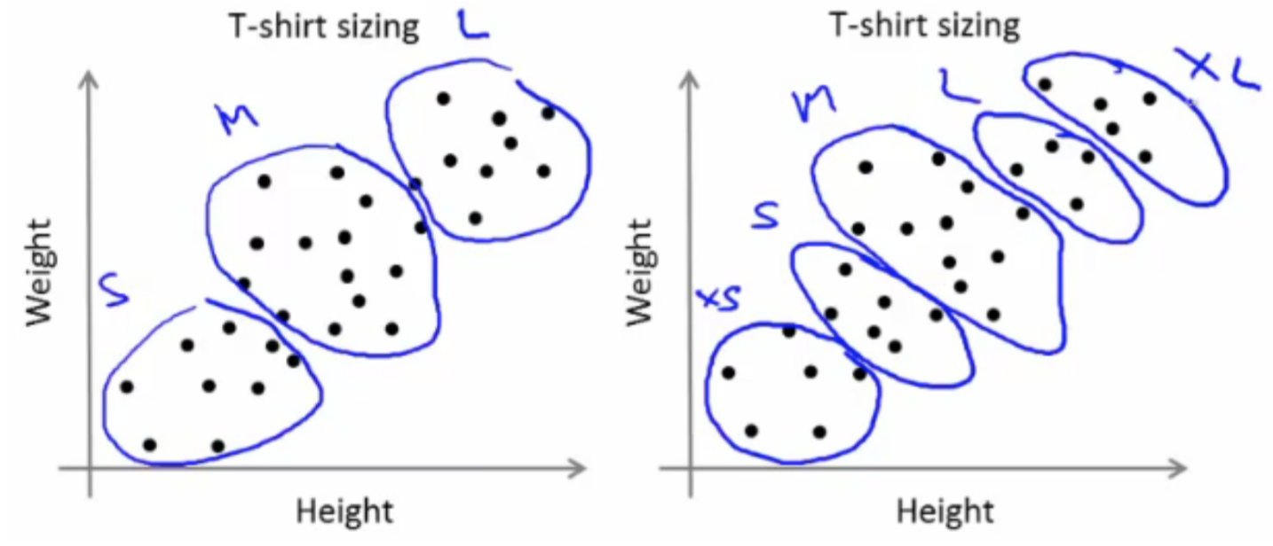
Unsupervised Learning
상세 내용
Another method for choosing K
Using K-means for market segmentation
Running K-means for a later/downstream purpose
See how well different number of clusters serve you later needs
e.g.
T-shirt size example
If you have three sizes (S,M,L)
Or five sizes (XS, S, M, L, XL)
Run K means where K = 3 and K = 5

Slide 19
Unsupervised Learning
Clustering
Dimensionality Reduction
Motivation
Principal Component Analysis (PCA)
Applying PCA
Anomaly Detection
Density Estimation
Building an Anomaly Detection System
Multivariate Gaussian Distribution

Slide 20
Dimensionality Reduction
상세 내용
Dimensionality Reduction (PCA)
Motivation 1: Data compression
Motivation 2: Visualization
Compression
Speeds up algorithms
Reduces space used by data for them
What is dimensionality reduction?
So you've collected many features - maybe more than you need
Can you "simply" your data set in a rational and useful way?
Example
Redundant data set - different units for same attribute
Reduce data to 1D (2D->1D)

Slide 21
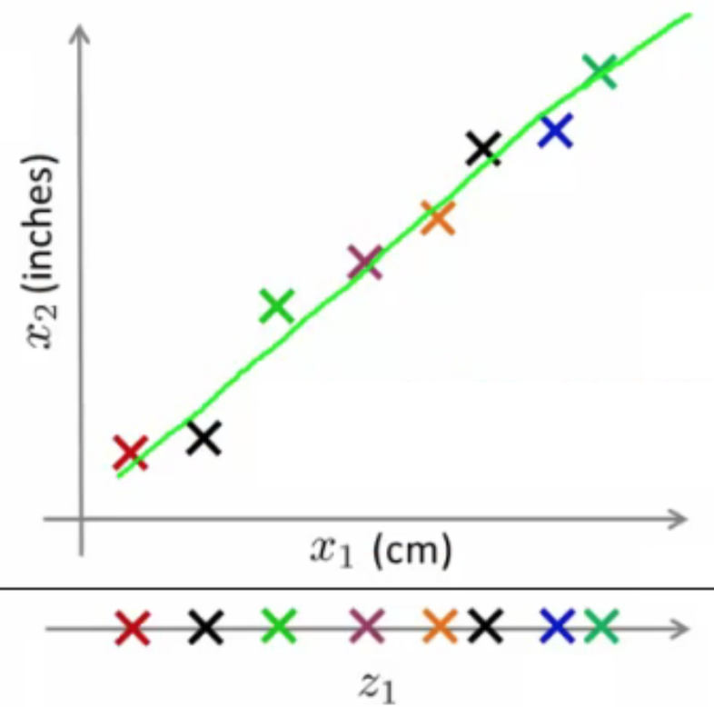
Dimensionality Reduction
상세 내용
Compression
What does dimensionality reduction mean?
In our example we plot a line
Take exact example and record position on that line
So we approximate original examples
Allows us to half the amount of storage
Gives lossy compression, but an acceptable loss (probably)

Slide 22
Dimensionality Reduction
상세 내용
Visualization
It's hard to visualize highly dimensional data
Dimensionality reduction can improve how we display information in a tractable manner for human consumption
Why do we care?
Often helps to develop algorithms if we can understand our data better
Dimensionality reduction helps us do this, see data in a helpful
Good for explaining something to someone if you can "show" it in the data

Slide 23
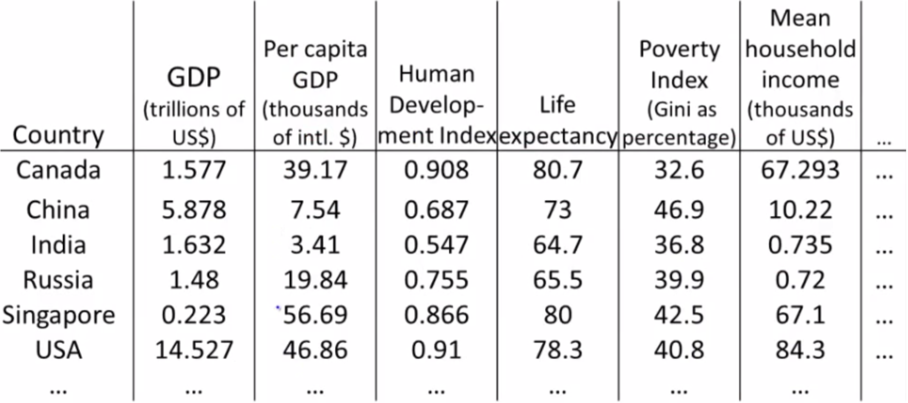
Dimensionality Reduction
상세 내용
Visualization
Example;
Collect a large data set about many facts of a country around the world

Slide 24
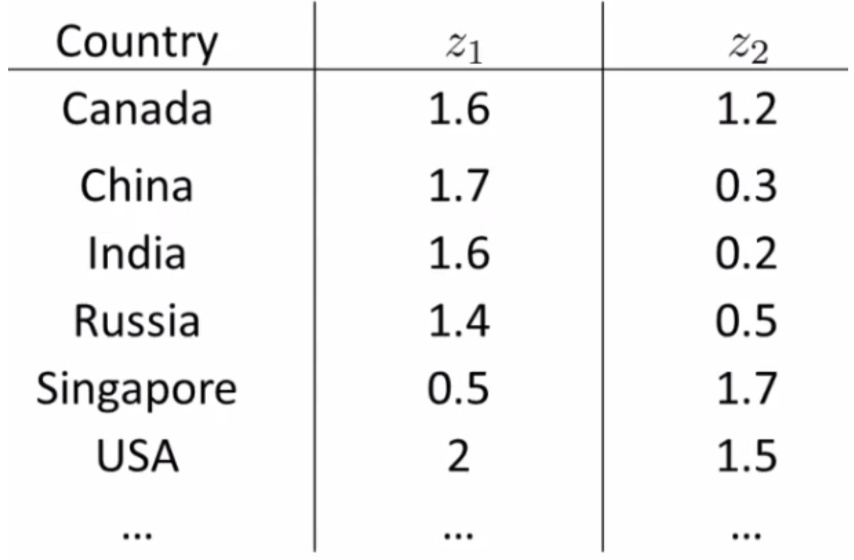
Dimensionality Reduction
상세 내용
Visualization
Using dimensionality reduction, instead of each country being represented by a 50-dimensional feature vector
Come up with a different feature representation (z values) which summarize these features

Slide 25
Dimensionality Reduction
상세 내용
Visualization
Typically you don't generally ascribe meaning to the new features (so we have to determine what these summary values mean)
e.g. may find horizontal axis corresponds to overall country size/economic activity
and y axis may be the per-person well being/economic activity
So despite having redundant features, there may be two "dimensions" of information, with features associated with each of those dimensions
It's up to you to asses what of the features can be grouped to form summary features, and how best to do that (feature scaling is probably important)
Helps show the two main dimensions of variation in a way that's easy to understand

Slide 26
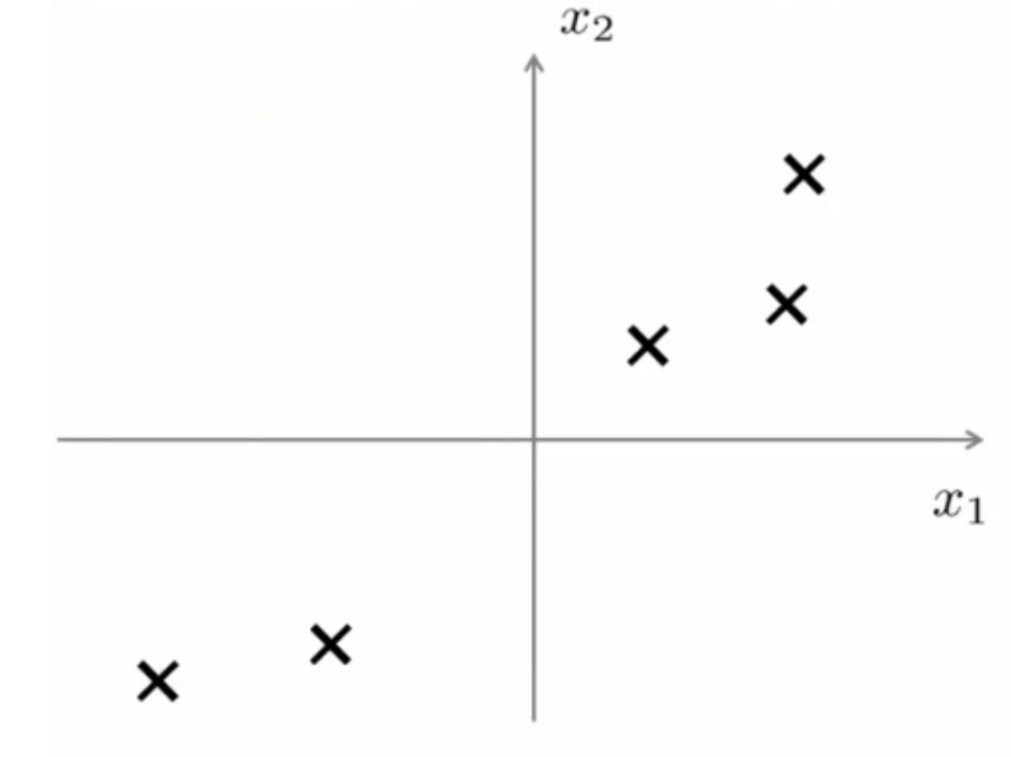
Dimensionality Reduction
상세 내용
Principle Component Analysis (PCA): Problem Formulation
For the problem of dimensionality reduction the most commonly used algorithm is PCA
Say we have a 2D data set which we wish to reduce to 1D

Slide 27
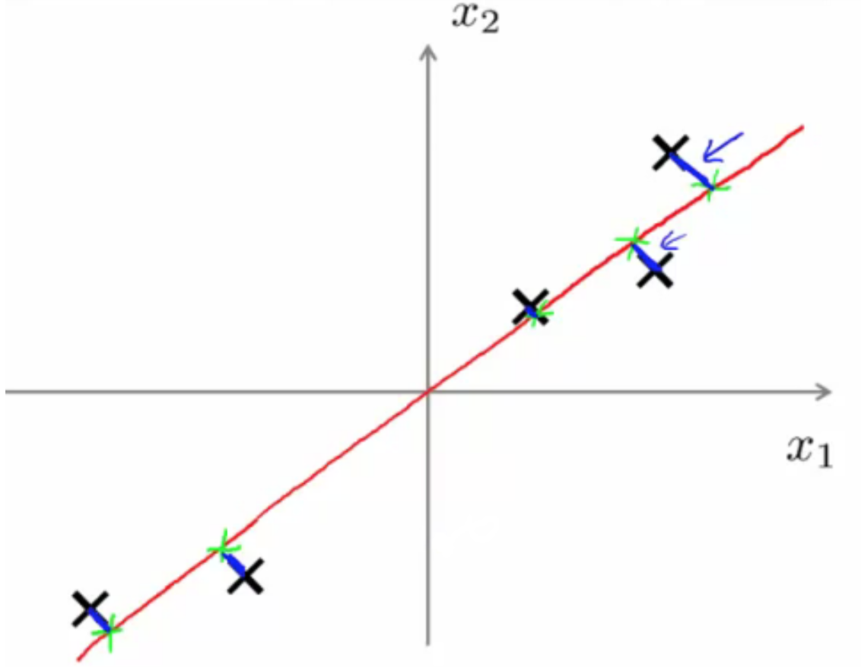
Dimensionality Reduction
상세 내용
Principle Component Analysis (PCA): Problem Formulation
Find a single line onto which to project this data
How do we determine this line?
The distance between each point and the projected version should be small (blue lines below are short)
PCA tries to find a lower dimensional surface so the sum of squares onto that surface is minimized
The blue lines are sometimes called the projection error

Slide 28
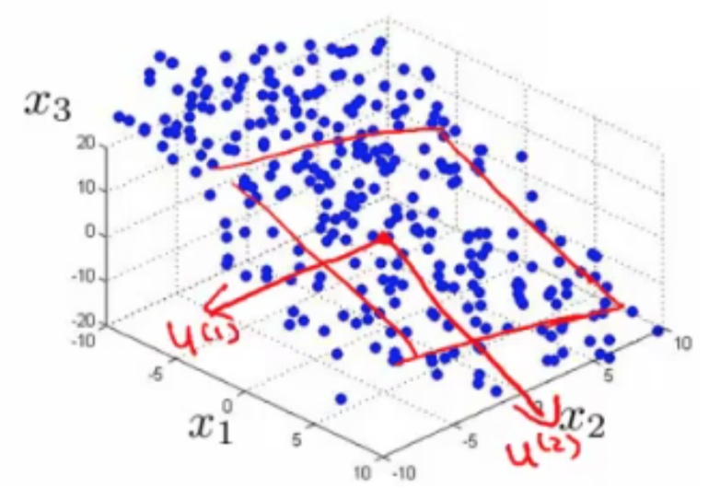
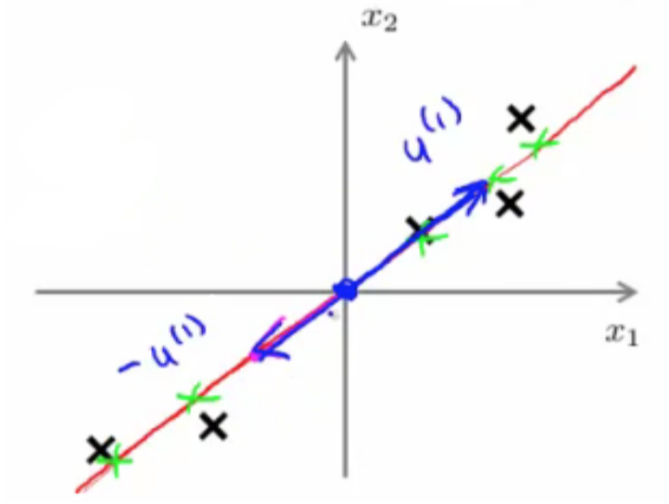
Dimensionality Reduction
상세 내용
Principle Component Analysis (PCA): Problem Formulation
In the more general case
To reduce from n-D to k-D we
Find k vectors (u(1), u(2), ... u(k)) onto which to project the data to minimize the projection error
So lots of vectors onto which we project the data
Find a set of vectors which we project the data onto the linear subspace spanned by that set of vectors
We can define a point in a plane with k vectors

Slide 29
Dimensionality Reduction
상세 내용
PCA Algorithm
Before applying PCA must do data preprocessing
Given a set of m unlabeled examples we must do
Mean normalization
Replace each xji with xj - μj,
In other words, determine the mean of each feature set, and then for each feature subtract the mean from the value, so we re-scale the mean to be 0
Feature scaling (depending on data)
If features have very different scales then scale so they all have a comparable range of values
e.g. xji is set to (xj - μj) / sj
Where sj is some measure of the range, so could be
Biggest - smallest
Standard deviation (more commonly)

Slide 30
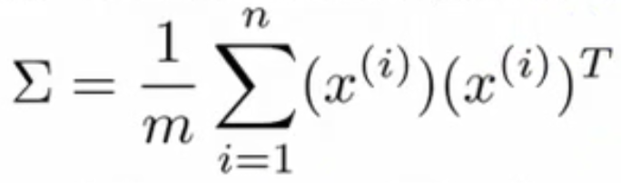
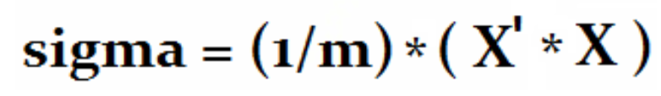
Dimensionality Reduction
상세 내용
PCA Algorithm Description
Reducing data from n-dimensional to k-dimensional
Compute the covariance matrix
This is commonly denoted as Σ (greek upper case sigma) - NOT summation symbol
Σ = sigma
This is an [n x n] matrix
Remember than xi is a [n x 1] matrix
In MATLAB or octave we can implement this as follows;

Slide 31
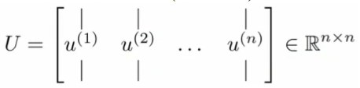
Dimensionality Reduction
상세 내용
PCA Algorithm Description
Compute eigenvectors of matrix Σ
[U,S,V] = svd(sigma)
svd = singular value decomposition
More numerically stable than eig
eig = also gives eigenvector
U,S and V are matrices
U matrix is also an [n x n] matrix
Turns out the columns of U are the u vectors we want!
So to reduce a system from n-dimensions to k-dimensions
Just take the first k-vectors from U (first k columns)

Slide 32
Dimensionality Reduction
상세 내용
PCA Algorithm Description
Next we need to find some way to change x (which is n dimensional) to z (which is k dimensional)
(reduce the dimensionality)
Take first k columns of the u matrix and stack in columns
n x k matrix - call this U_reduce
We calculate z as follows
z = (U_reduce)T * x
So [k x n] * [n x 1]
Generates a matrix which is
k*1
If that's not witchcraft I don't know what is!

Slide 33
Dimensionality Reduction
상세 내용
PCA Algorithm Description
Exactly the same as with supervised learning except we're now doing it with unlabeled data
So in summary
Preprocessing Calculate sigma (covariance matrix)
Calculate eigenvectors with svd
Take k vectors from U (U_reduce= U(:,1:k);)
Calculate z (z =U_reduce' * x;)
No mathematical derivation
Very complicated
But it works

Slide 34
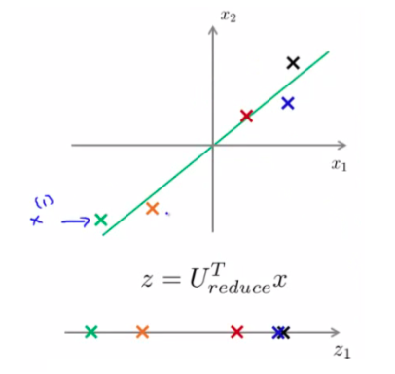
Dimensionality Reduction
상세 내용
Reconstruction from Compressed Representation
Say we have an example as follows
We have our examples (x1, x2 etc.)
Project onto z-surface
Given a point z1, how can we go back to the 2D space?

Slide 35
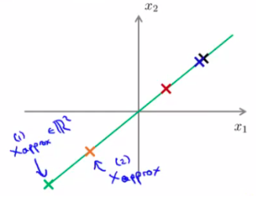
Dimensionality Reduction
상세 내용
Reconstruction from Compressed Representation
Considering
z (vector) = (U_reduce)T * x
To go in the opposite direction we must do
X_approx = U_reduce * z
To consider dimensions (and prove this really works)
U_reduce = [n x k]
z [k * 1]
So
X_approx = [n x 1]

Slide 36
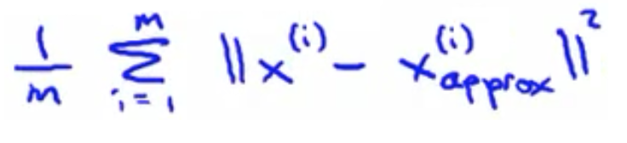
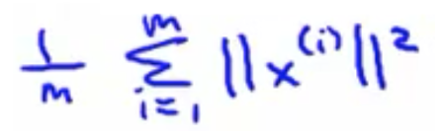
Dimensionality Reduction
상세 내용
Choosing the number of Principle Components
How do we chose k ?
k = number of principle components
Guidelines about how to chose k for PCA
To chose k think about how PCA works
PCA tries to minimize averaged squared projection error
Total variation in data can be defined as the average over data saying how far are the training examples from the origin

Slide 37
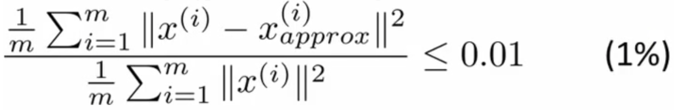
Dimensionality Reduction
상세 내용
Choosing the number of Principle Components
When we're choosing k typical to use something like this
Ratio between averaged squared projection error with total variation in data
Want ratio to be small - means we retain 99% of the variance
If it's small (0) then this is because the numerator is small
The numerator is small when xi = xapproxi
i.e. we lose very little information in the dimensionality reduction, so when we decompress we regenerate the same data

Slide 38
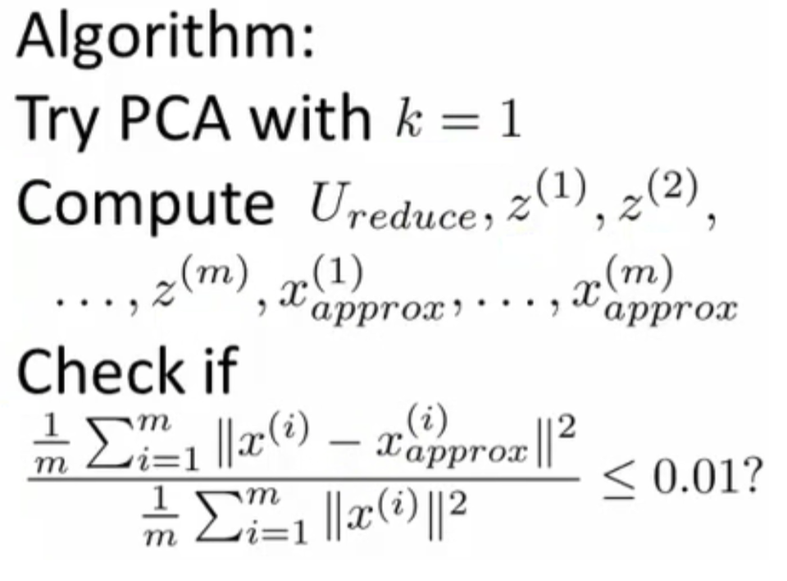
Dimensionality Reduction
상세 내용
Choosing the number of Principle Components

Slide 39
Dimensionality Reduction
상세 내용
Applications of PCA
Compression
Why
Reduce memory/disk needed to store data
Speed up learning algorithm
How do we chose k?
% of variance retained
Visualization
Typically chose k =2 or k = 3
Because we can plot these values!

Slide 40
Unsupervised Learning
Clustering
Dimensionality Reduction
Motivation
Principal Component Analysis (PCA)
Applying PCA
Anomaly Detection
Density Estimation
Building an Anomaly Detection System
Multivariate Gaussian Distribution

Slide 41
Anomaly Detection
상세 내용
Anomaly detection - problem motivation
Anomaly detection is a reasonably commonly used type of machine learning application
Can be thought of as a solution to an unsupervised learning problem
But, has aspects of supervised learning
What is anomaly detection?
Imagine you're an aircraft engine manufacturer
As engines roll off your assembly line you're doing QA
Measure some features from engines (e.g. heat generated and vibration)
You now have a dataset of x1 to xm (i.e. m engines were tested)
Say we plot that dataset

Slide 42
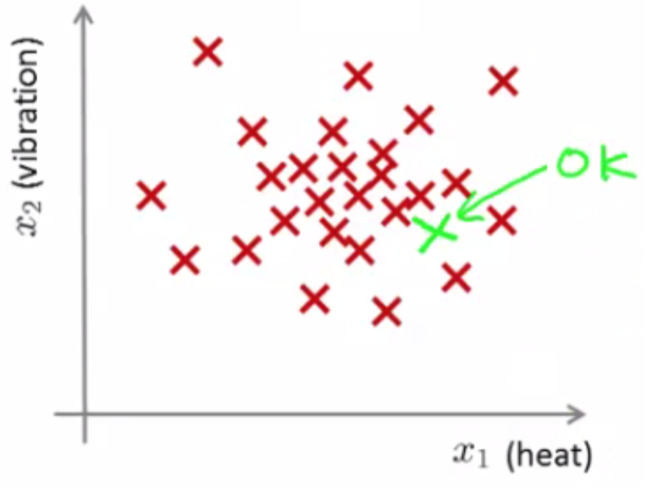
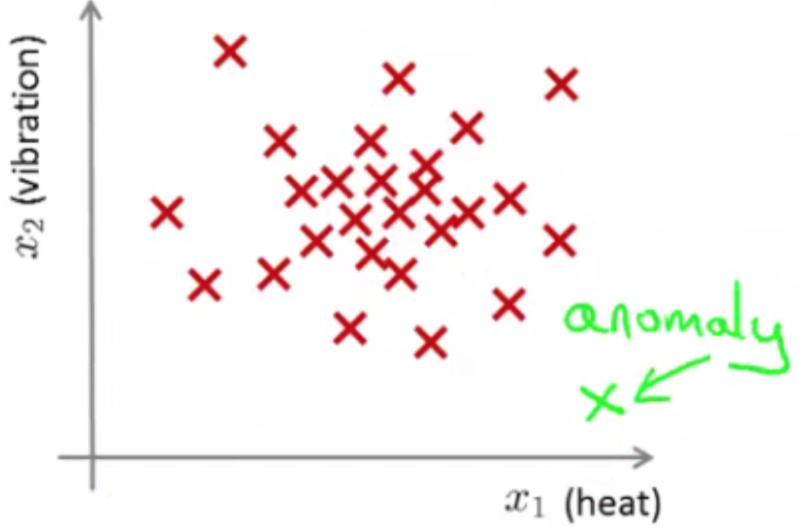
Anomaly Detection
상세 내용
Anomaly detection - problem motivation
Say we plot that dataset
We have a dataset which contains normal (data)
How we ensure they're normal is up to us
In reality it's OK if there are a few which aren't actually normal
Using that dataset as a reference point we can see if other examples are anomalous

Slide 43
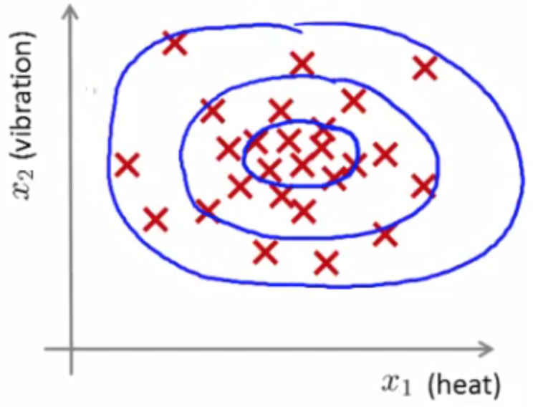
Anomaly Detection
상세 내용
Anomaly detection - problem motivation
How do we do this?
First, using our training dataset we build a model
We can access this model using p(x)
This asks, "What is the probability that example x is normal"
Having built a model
if p(xtest) < ε --> flag this as an anomaly
if p(xtest) >= ε --> this is OK
ε is some threshold probability value which we define, depending on how sure we need/want to be

Slide 44
Anomaly Detection
상세 내용
Anomaly detection - problem motivation
Applications
Fraud detection
Users have activity associated with them, such as
Length on time on-line
Location of login
Spending frequency
Using this data we can build a model of what normal users' activity is like
Manufacturing
Monitoring computers in data center
If you have many machines in a cluster
Computer features of machine
x1 = memory use x2 = number of disk accesses/sec
x3 = CPU load
x4 = CPU load/network traffic

Slide 45
Anomaly Detection
상세 내용
The Gaussian distribution (optional)
Also called the normal distribution
Say x (data set) is made up of real numbers
Mean is μ
Variance is σ^2 σ is also called the standard deviation - specifies the width of the Gaussian probability
The data has a Gaussian distribution
Then we can write this ~ N(μ,σ^2 )
~ means = is distributed as
N (should really be "script" N (even curlier!) -> means normal distribution
μ, σ^2 represent the mean and variance, respectively
These are the two parameters a Gaussian means

Slide 46
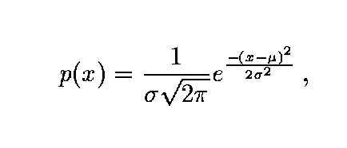
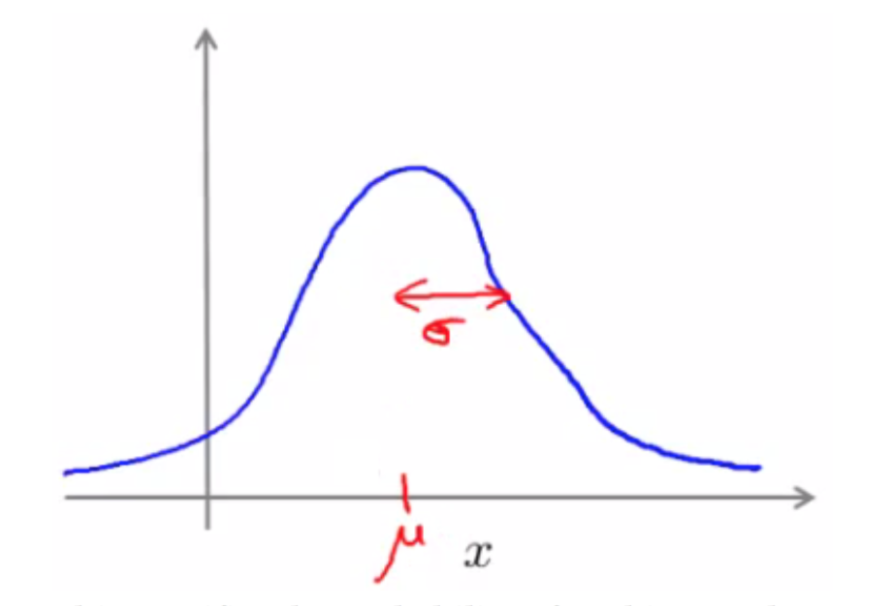
Anomaly Detection
상세 내용
The Gaussian distribution (optional)
Gaussian equation is
P(x : μ , σ2) (probability of x, parameterized by the mean and squared variance)

Slide 47
Anomaly Detection
상세 내용
Anomaly detection algorithm
Unlabeled training set of m examples
Data = {x1, x2, ..., xm }
Each example is an n-dimensional vector (i.e. a feature vector)
We have n features!
Model P(x) from the data set
What are high probability features and low probability features
x is a vector
So model p(x) as = p(x1; μ1 , σ1^2) * p(x2; μ2 , σ2^2) * ... p(xn ; μn , σn^2)
Multiply the probability of each features by each feature
We model each of the features by assuming each feature is distributed according to a Gaussian distribution
p(xi; μi , σi^2)
The probability of feature xi given μi and σi^2, using a Gaussian distribution

Slide 48
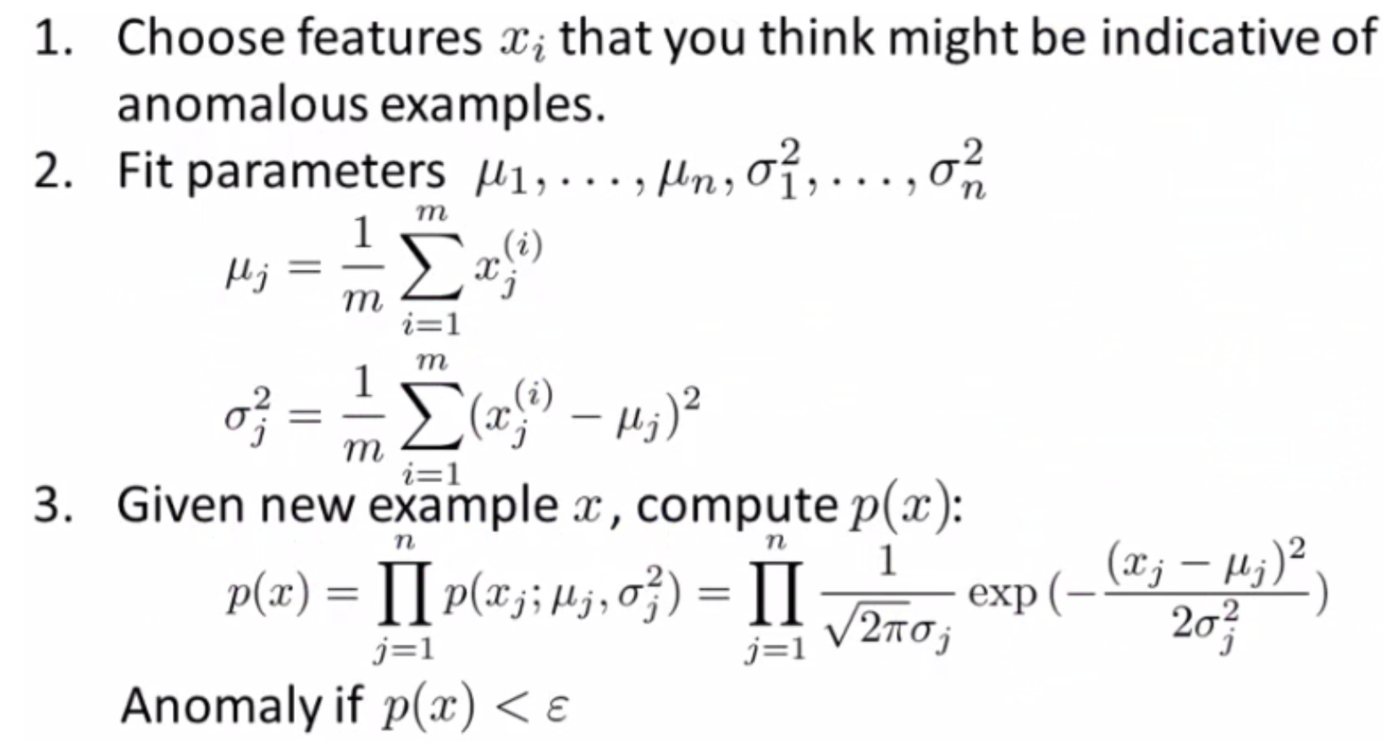
Anomaly Detection
상세 내용
Anomaly detection algorithm

Slide 49
Anomaly Detection
상세 내용
Anomaly detection algorithm
1 - Chose features
Try to come up with features which might help identify something anomalous - may be unusually large or small values
More generally, chose features which describe the general properties
This is nothing unique to anomaly detection - it's just the idea of building a sensible feature vector
2 - Fit parameters
Determine parameters for each of your examples μi and σi2
Fit is a bit misleading, really should just be "Calculate parameters for 1 to n"
So you're calculating standard deviation and mean for each feature
You should of course used some vectorized implementation rather than a loop probably
3 - compute p(x)
You compute the formula shown (i.e. the formula for the Gaussian probability)
If the number is very small, very low chance of it being "normal"

Slide 50
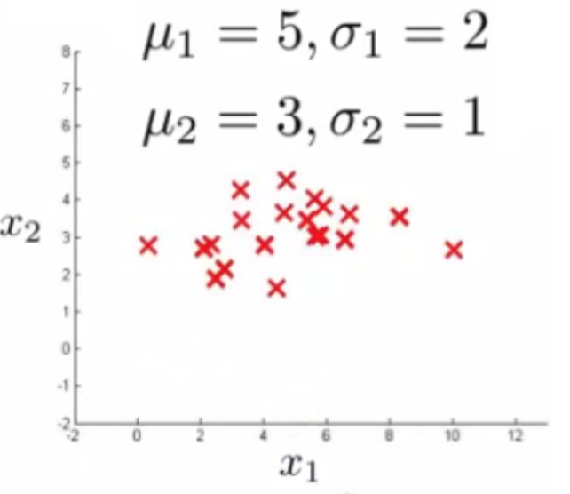
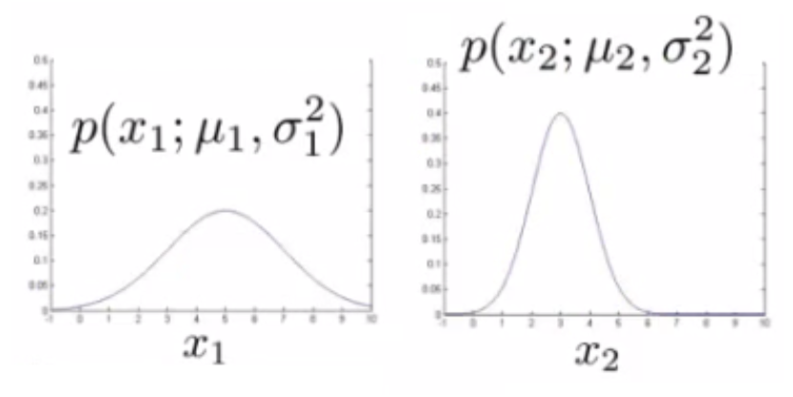
Anomaly Detection
상세 내용
Anomaly detection example
x1
Mean is about 5
Standard deviation looks to be about 2
x2
Mean is about 3
Standard deviation about 1

Slide 51
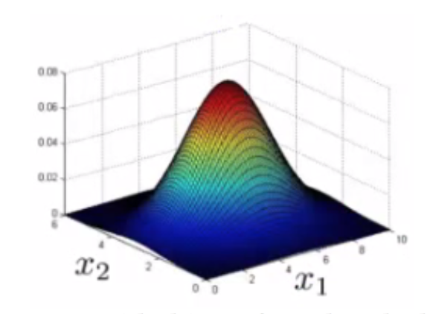
Anomaly Detection
상세 내용
Anomaly detection example
Check if a value is anomalous
Set epsilon as some value
Say we have two new data points new data-point has the values
x1_test
x2_test
We compute
p(x1test) = 0.436 >= epsilon (~40% chance it's normal) Normal
p(x2test) = 0.0021 < epsilon (~0.2% chance it's normal) Anomalous

Slide 52
Anomaly Detection
상세 내용
Developing and evaluating and anomaly detection system
Previously we spoke about the importance of real-number evaluation
Often need to make a lot of choices (e.g. features to use)
Easier to evaluate your algorithm if it returns a single number to show if changes you made improved or worsened an algorithm's performance
To develop an anomaly detection system quickly, would be helpful to have a way to evaluate your algorithm
Assume we have some labeled data
So far we've been treating anomalous detection with unlabeled data
If you have labeled data allows evaluation
i.e. if you think something iss anomalous you can be sure if it is or not

Slide 53
Anomaly Detection
상세 내용
Developing and evaluating and anomaly detection system
So, taking our engine example
You have some labeled data
Data for engines which were non-anomalous -> y = 0
Data for engines which were anomalous -> y = 1
Training set is the collection of normal examples
OK even if we have a few anomalous data examples
Next define
Cross validation set
Test set
For both assume you can include a few examples which have anomalous examples

Slide 54
Anomaly Detection
상세 내용
Developing and evaluating and anomaly detection system
Specific example
Engines
Have 10 000 good engines
OK even if a few bad ones are here...
LOTS of y = 0
20 flawed engines
Typically when y = 1 have 2-50
Split into
Training set: 6000 good engines (y = 0)
CV set: 2000 good engines, 10 anomalous
Test set: 2000 good engines, 10 anomalous
Ratio is 3:1:1
Sometimes we see a different way of splitting
Take 6000 good in training
Same CV and test set (4000 good in each) different 10 anomalous,
Or even 20 anomalous (same ones)
This is bad practice - should use different data in CV and test set

Slide 55
Anomaly Detection
상세 내용
Developing and evaluating and anomaly detection system
Algorithm evaluation
Take trainings set { x1, x2, ..., xm }
Fit model p(x)
On cross validation and test set, test the example x
y = 1 if p(x) < epsilon (anomalous)
y = 0 if p(x) >= epsilon (normal)
Think of algorithm a trying to predict if something is anomalous
But you have a label so can check!
Makes it look like a supervised learning algorithm
What's a good metric to use for evaluation
y = 0 is very common
So classification would be bad
Compute fraction of true positives/false positive/false negative/true negative
Compute precision/recall
Compute F1-score
Earlier, also had epsilon (the threshold value)
Threshold to show when something is anomalous If you have CV set you can see how varying epsilon effects various evaluation metrics
Then pick the value of epsilon which maximizes the score on your CV set
Evaluate algorithm using cross validation
Do final algorithm evaluation on the test set

Slide 56
Anomaly Detection
상세 내용
Anomaly detection vs. supervised learning
Anomaly detection
Very small number of positive examples
Save positive examples just for CV and test set
Consider using an anomaly detection algorithm
Not enough data to "learn" positive examples
Have a very large number of negative examples
Use these negative examples for p(x) fitting
Only need negative examples for this
Many "types" of anomalies
Hard for an algorithm to learn from positive examples when anomalies may look nothing like one another
So anomaly detection doesn't know what they look like, but knows what they don't look like
When we looked at SPAM email,
Many types of SPAM
For the spam problem, usually enough positive examples
So this is why we usually think of SPAM as supervised learning
Supervised learning
Reasonably large number of positive and negative examples
Have enough positive examples to give your algorithm the opportunity to see what they look like
If you expect anomalies to look anomalous in the same way

Slide 57
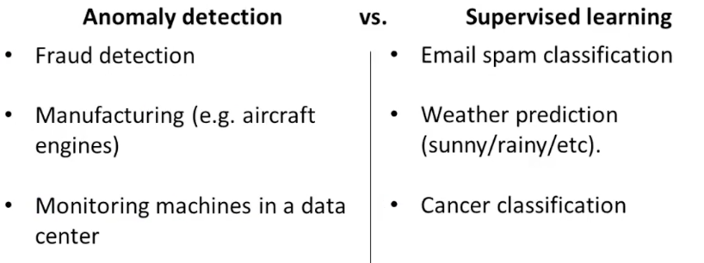
Anomaly Detection
상세 내용
Anomaly detection vs. supervised learning

Slide 58
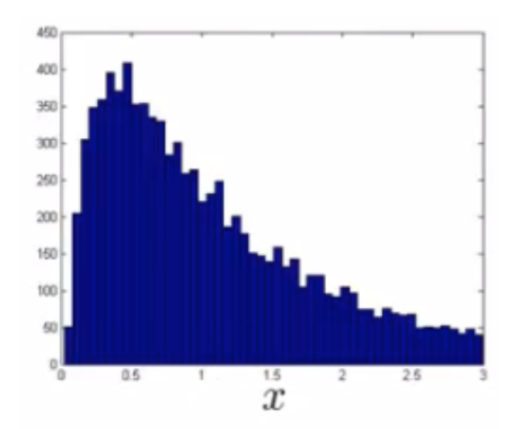
Anomaly Detection
상세 내용
Choosing features to use
One of the things which has a huge effect is which features are used
Non-Gaussian features
Plot a histogram of data to check it has a Gaussian description - nice sanity check
Often still works if data is non-Gaussian
Use hist command to plot histogram
Non-Gaussian data might look like this

Slide 59
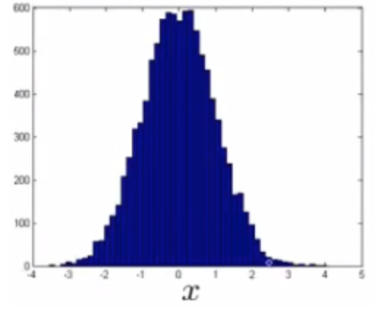
Anomaly Detection
상세 내용
Choosing features to use
Can play with different transformations of the data to make it look more Gaussian
Might take a log transformation of the data
i.e. if you have some feature x1, replace it with log(x1)
Or do log(x1+c)
Play with c to make it look as Gaussian as possible
Or do x1/2
Or do x1/3

Slide 60
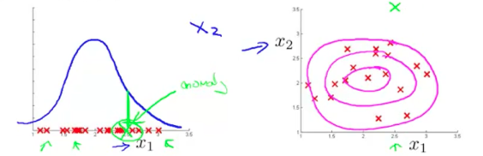
Anomaly Detection
상세 내용
Error analysis for anomaly detection
Like supervised learning error analysis procedure
Run algorithm on CV set
See which one it got wrong
Develop new features based on trying to understand why the algorithm got those examples wrong
Example
p(x) large for normal, p(x) small for abnormal
e.g.

Slide 61
Anomaly Detection
상세 내용
Error analysis for anomaly detection
Example - data center monitoring
Features
x1 = memory use
x2 = number of disk access/sec
x3 = CPU load
x4 = network traffic
We suspect CPU load and network traffic grow linearly with one another
If server is serving many users, CPU is high and network is high
Fail case is infinite loop, so CPU load grows but network traffic is low
New feature - CPU load/network traffic
May need to do feature scaling

Slide 62
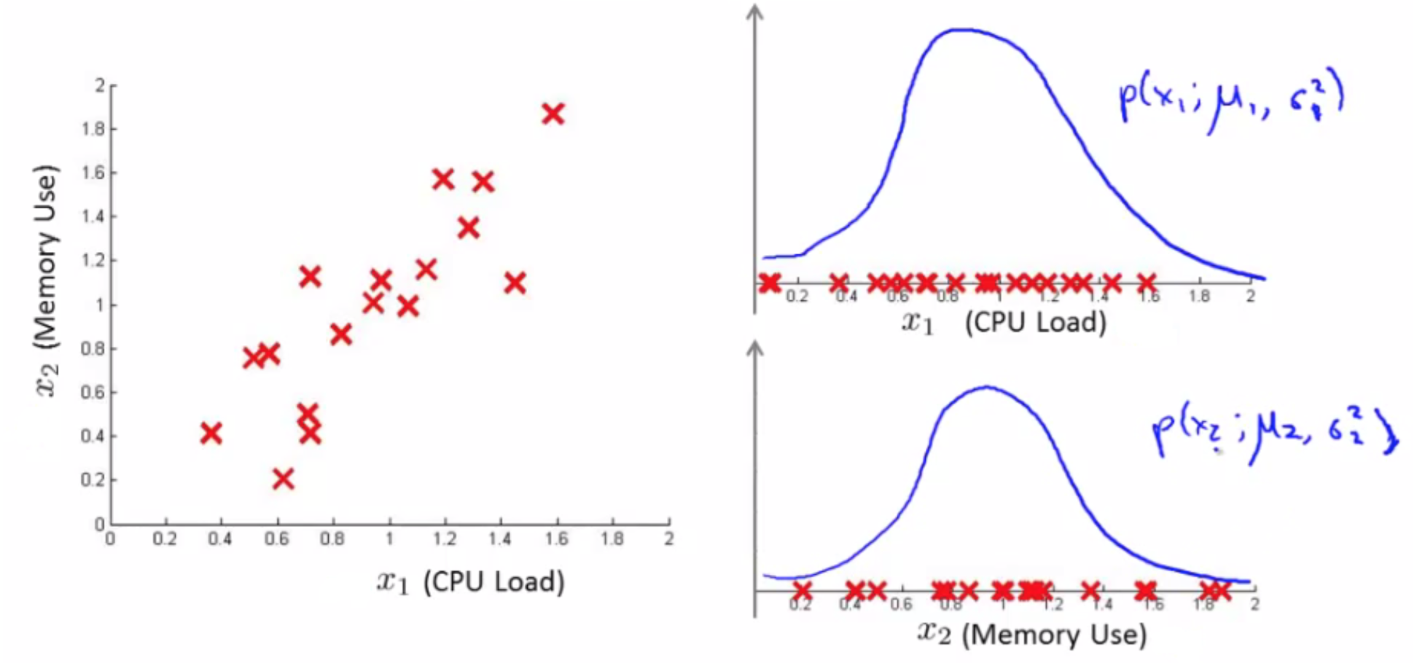
Anomaly Detection
상세 내용
Multivariate Gaussian distribution
Is a slightly different technique which can sometimes catch some anomalies which non-multivariate Gaussian distribution anomaly detection fails to Unlabeled data looks like this;

Slide 63
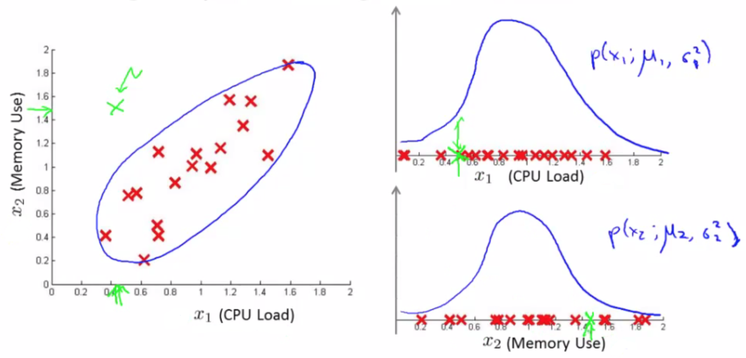
Anomaly Detection
상세 내용
Multivariate Gaussian distribution
Problem is, if we look at each feature individually they may fall within acceptable limits - the issue is we know we shouldn't don't get those kinds of values together
But individually, they're both acceptable

Slide 64
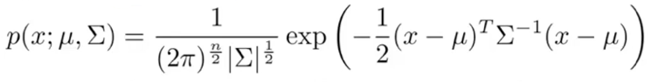
Anomaly Detection
상세 내용
Multivariate Gaussian distribution model
To get around this we develop the multivariate Gaussian distribution
Model p(x) all in one go, instead of each feature separately
What are the parameters for this new model?
μ - which is an n dimensional vector (where n is number of features)
Σ - which is an [n x n] matrix - the covariance matrix

Slide 65
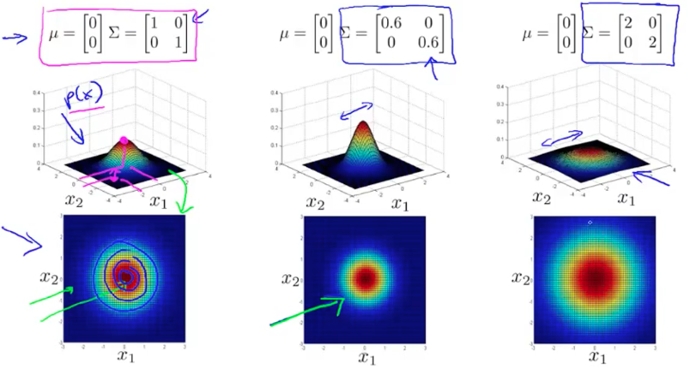
Anomaly Detection
상세 내용
Multivariate Gaussian distribution model

Slide 66
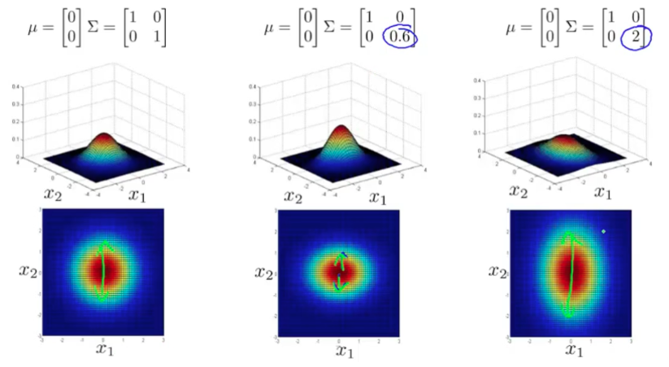
Anomaly Detection
상세 내용
Multivariate Gaussian distribution model

Slide 67
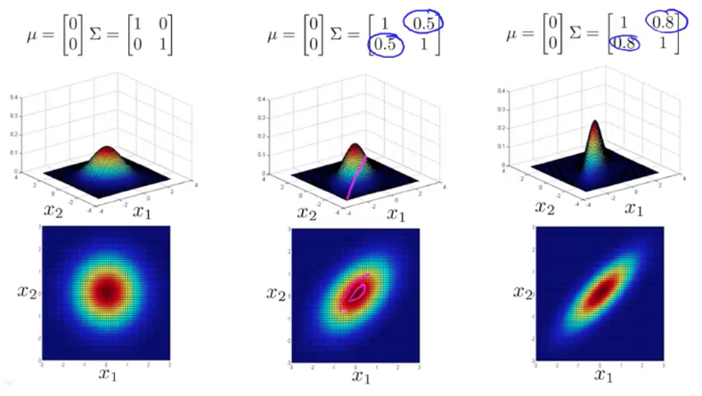
Anomaly Detection
상세 내용
Multivariate Gaussian distribution model

Slide 68
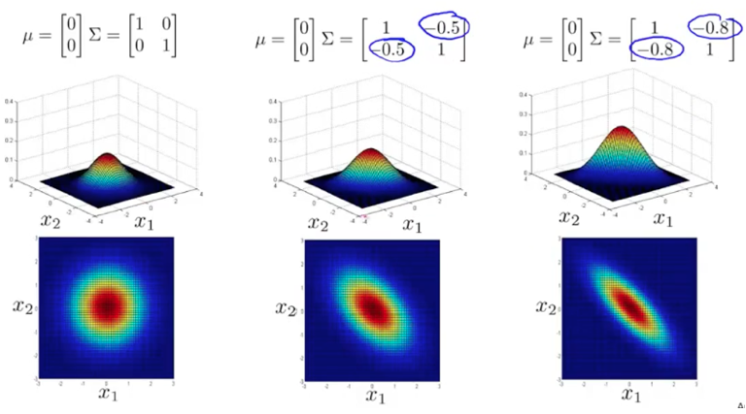
Anomaly Detection
상세 내용
Multivariate Gaussian distribution model

Slide 69
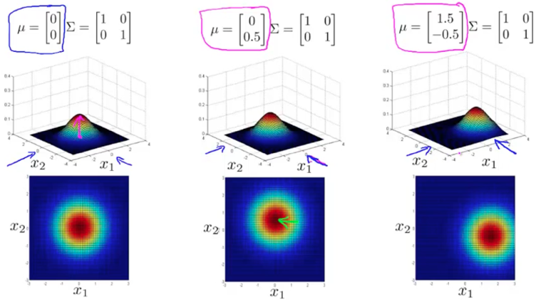
Anomaly Detection
상세 내용
Multivariate Gaussian distribution model

Slide 70
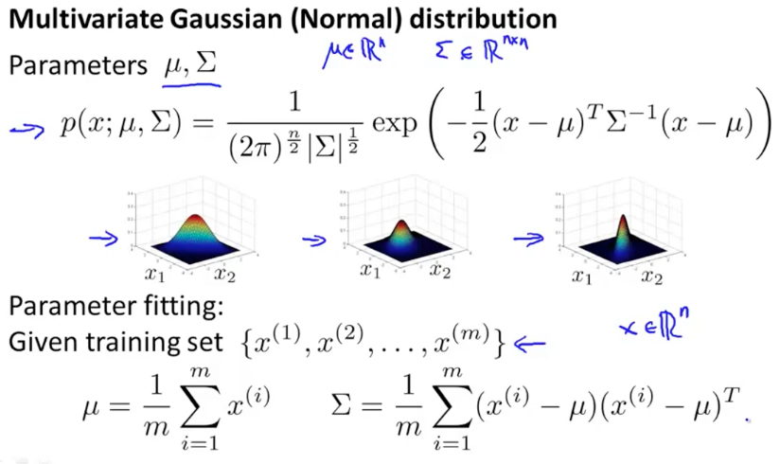
Anomaly Detection
상세 내용
Multivariate Gaussian distribution model

Slide 71


Anomaly Detection
상세 내용
Applying multivariate Gaussian distribution to anomaly detection
multivariate Gaussian modeling uses the following equation;
Which comes with the parameters μ and Σ
Where
μ - the mean (n-dimenisonal vector)
Σ - covariance matrix ([nxn] matrix)
Parameter fitting/estimation problem
If you have a set of examples
{x1, x2, ..., xm }
The formula for estimating the parameters is

Slide 72


Anomaly Detection
상세 내용
Applying multivariate Gaussian distribution to anomaly detection
1) Fit model - take data set and calculate μ and Σ using the formula above
2) We're next given a new example (x_test) - see below
For it compute p(x) using the following formula for multivariate distribution
3) Compare the value with ε (threshold probability value)
if p(xtest) < ε --> flag this as an anomaly
if p(xtest) >= ε --> this is OK

Slide 73
Anomaly Detection
상세 내용
Original model vs. Multivariate Gaussian
Original Gaussian model
Probably used more often
There is a need to manually create features to capture anomalies where x1 and x2 take unusual combinations of values
So need to make extra features
Might not be obvious what they should be
This is always a risk - where you're using your own expectation of a problem to "predict" future anomalies
Typically, the things that catch you out aren't going to be the things you though of
If you thought of them they'd probably be avoided in the first place
Obviously this is a bigger issue, and one which may or may not be relevant depending on your problem space
Much cheaper computationally
Scales much better to very large feature vectors
Even if n = 100 000 the original model works fine
Works well even with a small training set
e.g. 50, 100
Because of these factors it's used more often because it really represents a optimized but axis-symmetric specialization of the general model

Slide 74
Anomaly Detection
상세 내용
Original model vs. Multivariate Gaussian
Multivariate Gaussian model
Used less frequently
Can capture feature correlation
So no need to create extra values
Less computationally efficient
Must compute inverse of matrix which is [n x n]
So lots of features is bad - makes this calculation very expensive
So if n = 100 000 not very good
Needs for m > n
i.e. number of examples must be greater than number of features
If this is not true then we have a singular matrix (non-invertible)
So should be used only in m >> n
If you find the matrix is non-invertible, could be for one of two main reasons
m<n
So use original simple model
Redundant features (i.e. linearly dependent)
i.e. two features that are the same
If this is the case you could use PCA or sanity check your data

